Slide 1

Demo CubeMX-AI:
A CIFAR10 classification
Alessio Burrello,
alessio.burrello@unibo.it
Credits: Marcello Zanghieri,
Enrico Tabanelli

Slide 2
Summary
Creation of the python model and production of the saved model (.h5)
Creation of the CubeMX project and validation on NUCLEO-H743ZI
Creation of the application for network inference
Application: sending images from PC through serial communication, and classifying them on the board.

Slide 3
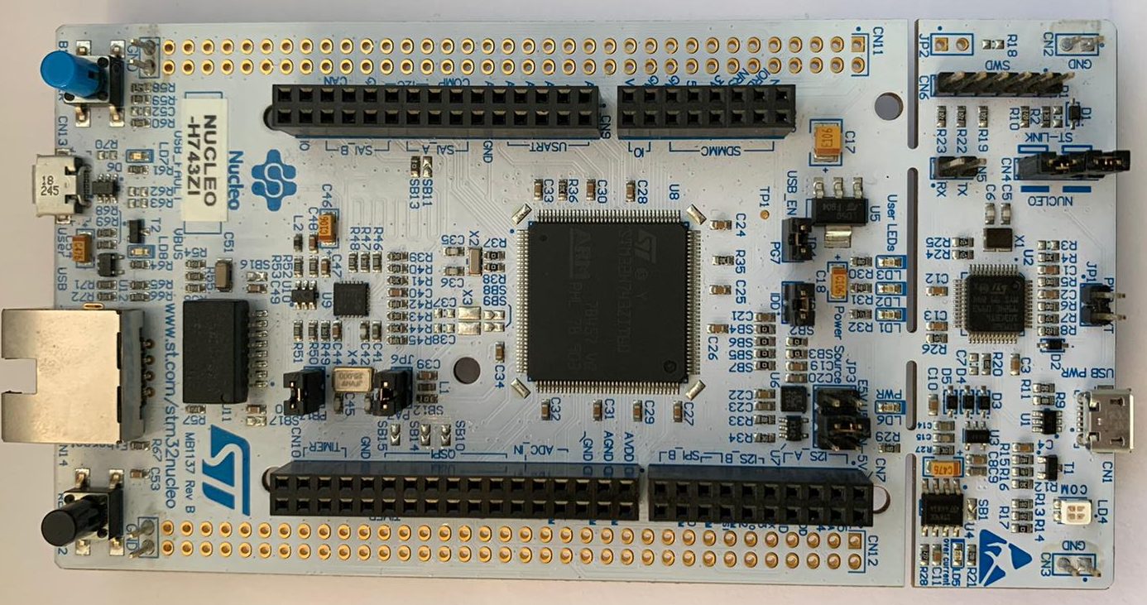
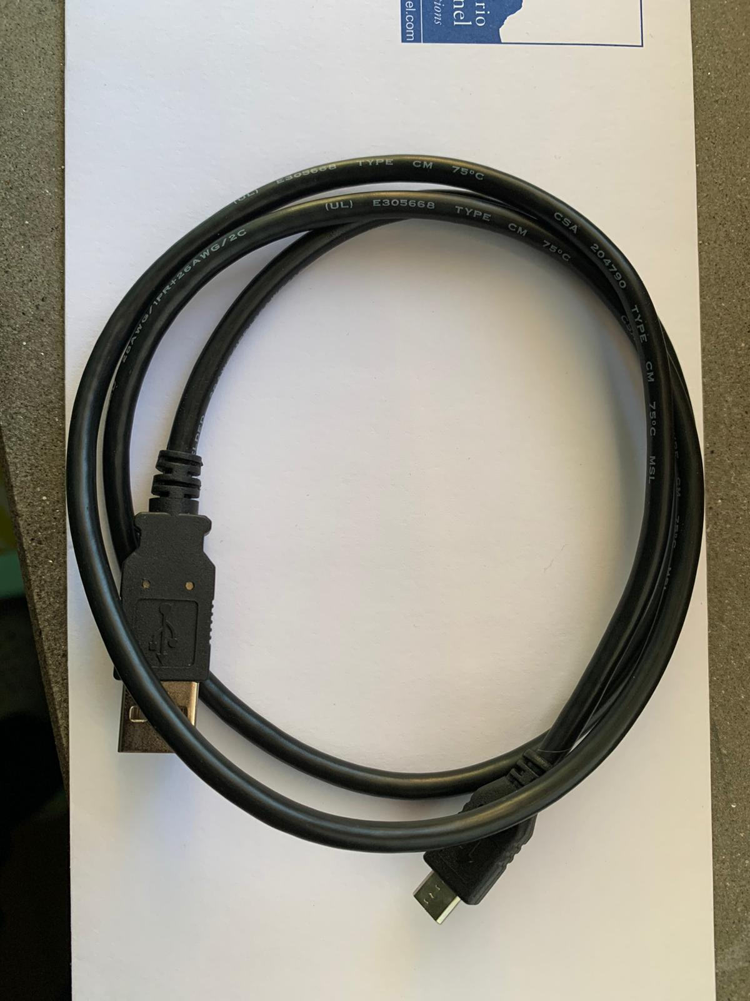
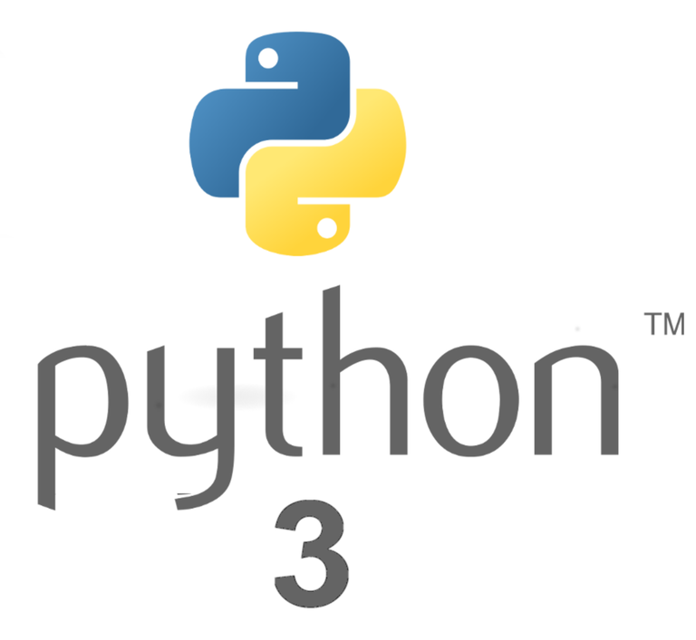
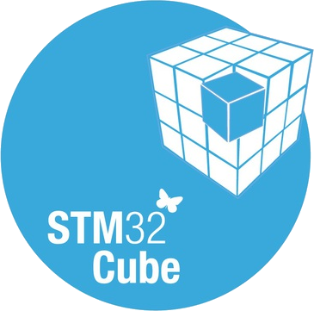
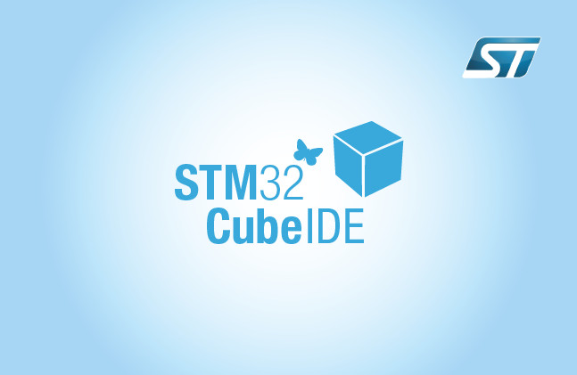
Material
PC with Windows + VM with Linux
Python 3.x
STMCubeMX-AI
STM32CubeIDE
NUCLEO-H743ZI
Cable to connect

Slide 4
Material
Download Demo link:
https://github.com/ABurrello/CubeMX-AI-demo
STM32CubeMX-AI projects:
https://www.dropbox.com/s/yi93l4zwf9le1wl/Projects.zip?dl=0

Slide 5
Summary
Creation of the python network and production of the saved model (.h5)
Creation of the CubeMX project and validation on NUCLEO-H743ZI
Creation of the application for network inference
Application: sending images from PC through serial communication, and classifying them on the board.

Slide 6
Requirements
Python 3.5.
Keras framework
Tensorflow backend
Alternatives
Caffè, tflite → not shown here.

Slide 7
Python network generation: keras
Dependencies
Keras
Tensorflow
Running Keras CIFAR10 network example

Slide 8
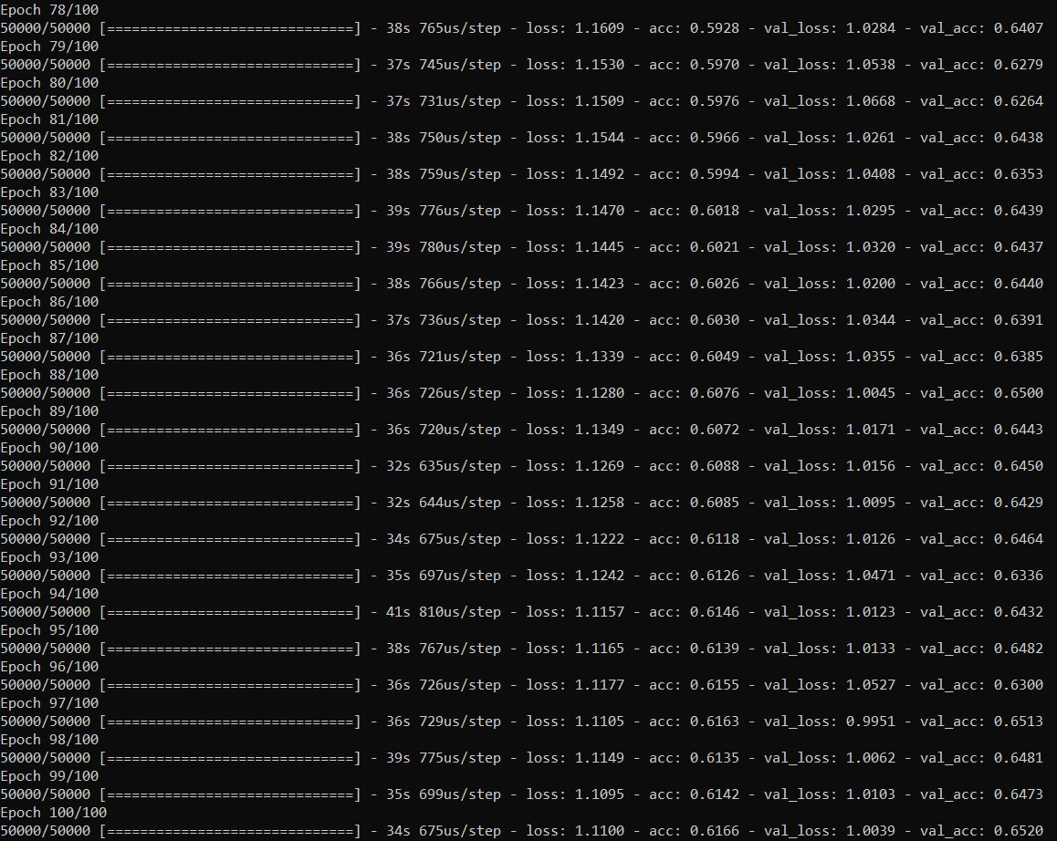
Python network generation: keras
Training of the network
How to train
Launch CIFAR10 network example, that you find in the folder
Change the following parameters, to generate more models:
batch_size = 32
num_classes = 10
epochs = 200
data_augmentation = True
num_predictions = 20
save_dir = os.path.join(os.getcwd(), 'saved_models’)
model_name = 'keras_cifar10_trained_model_200_epochs.h5'

Slide 9
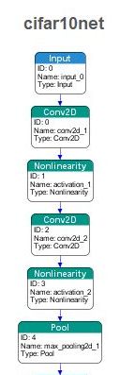
Python network generation: keras
Generated model:
.h5 file, with topology + weights
a CNN network with conv2d, poolings, Relu, Dropout and Dense Layers
Block 1 as visualized from CubeMX-AI
Full network contains:
3 blocks identical to the presented one;
2 final Fully connected layers

Slide 10
Summary
Creation of the python network and production of the saved model (.h5)
Creation of the CubeMX project and validation on NUCLEO-H743ZI
Creation of the application for network inference
Application: sending images from PC through serial communication, and classifying them on the board.

Slide 11
Requirements
Saved .h5 model of a trained Neural Network
STM32CubeMX with AI4.1 extension
NUCLEO-H743ZI
Alternatives
Other ST boards.

Slide 12
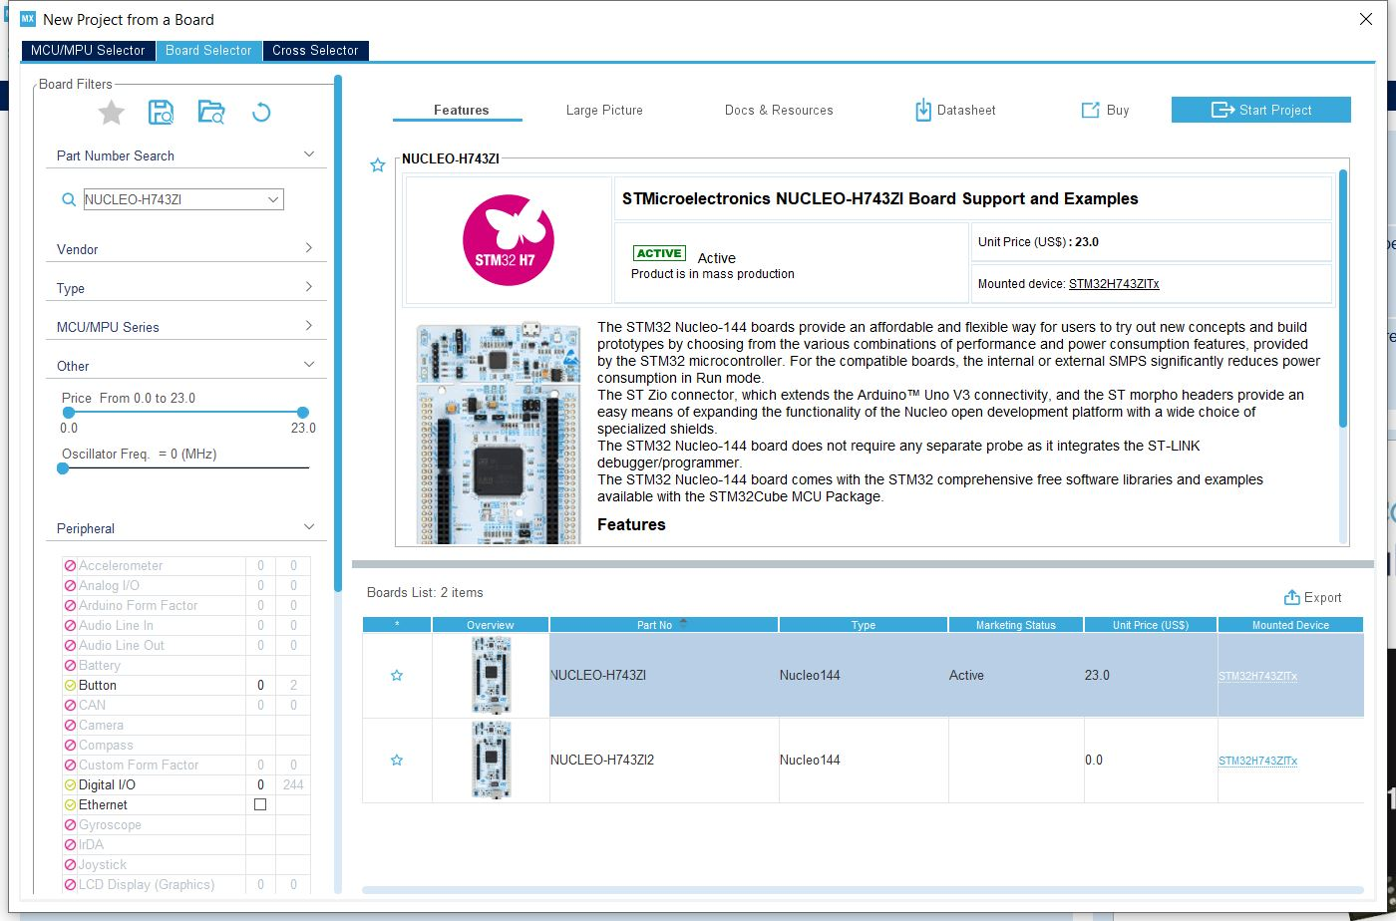
STM32CubeMX: New project
Create a new project
Select Board Selector
Select NUCLEO-H743ZI
Select a different board if you have a different one.

Slide 13
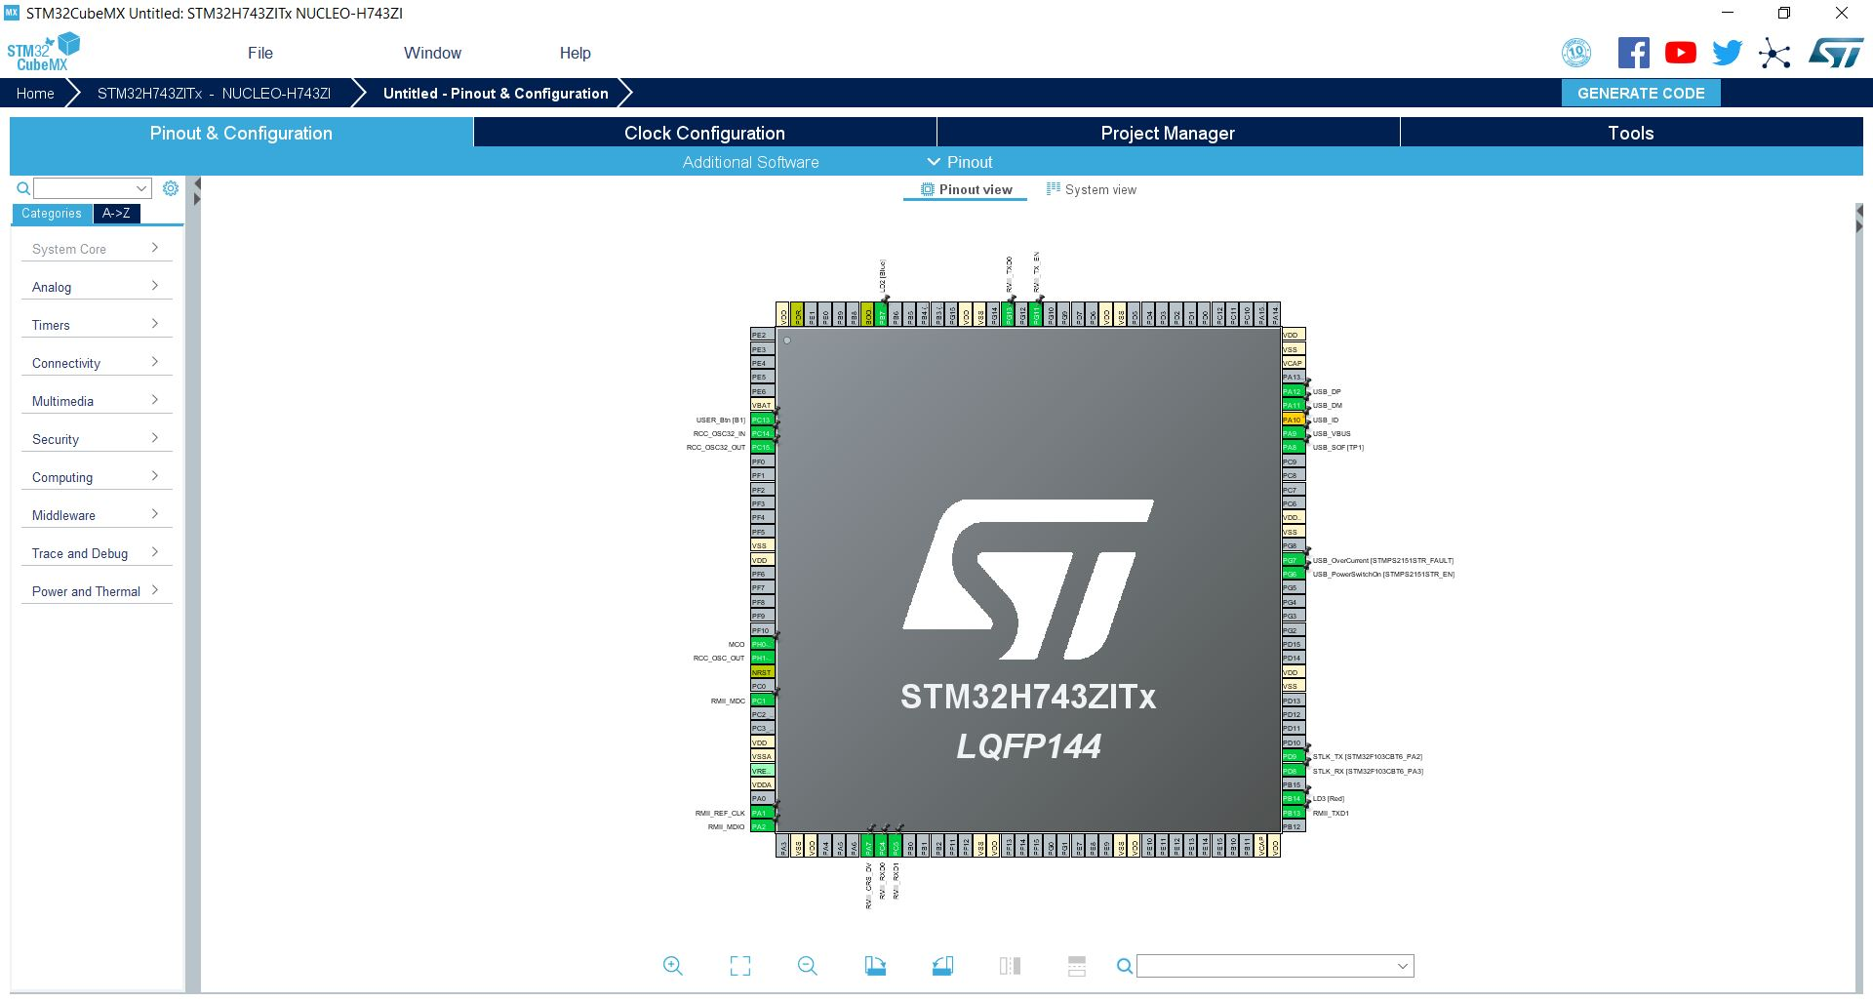
STM32CubeMX: add AI
Use the Additional software to add a validation application of a Neural network.
Validate the execution of the NN on the NUCLEO-H7.

Slide 14
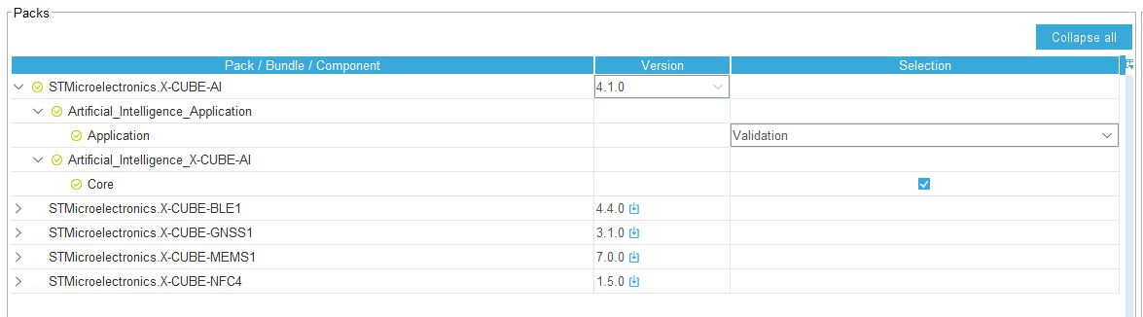
STM32CubeMX: add AI
Select Validation to validate your application (check memory and accuracy of the result → MSE compared to PC model)

Slide 15
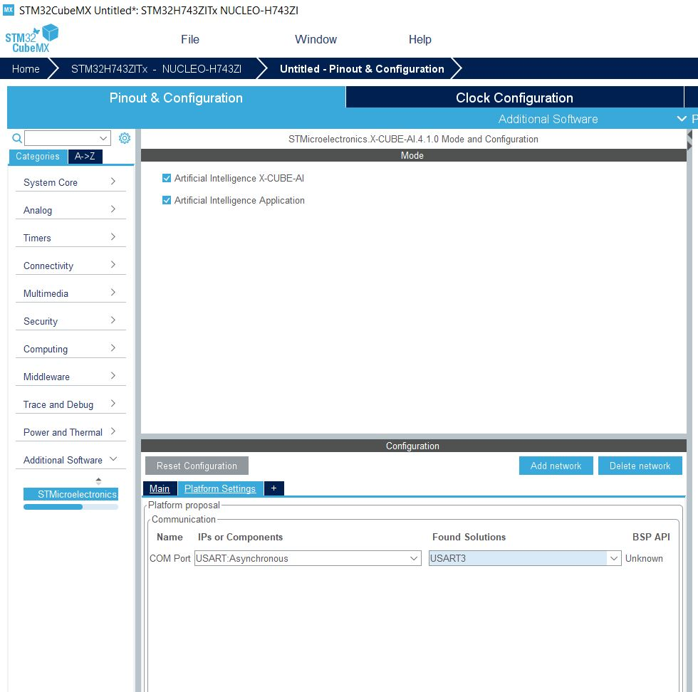
STM32CubeMX-AI: Configuration of the network
Additional software configured

Slide 16
STM32CubeMX-AI: Configuration of the network
Additional software configured
Configure the USART3 for validation in Platform settings.
If not automatically activated, remember to activate USART3 in Connectivity
N.B. USART3 is the one connected to the STLINK for NUCLEO-H7. Check the right one on your board.

Slide 17
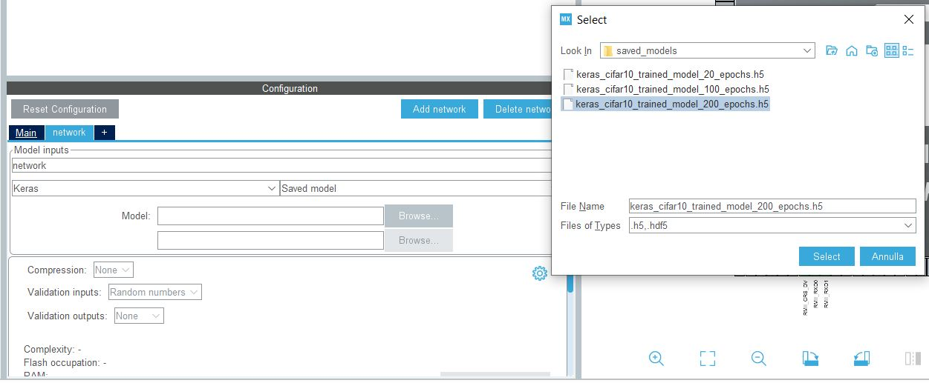
STM32CubeMX-AI: Add a network
Select keras, saved model.
Change name of Model input to cifar10net
Import a network from saved models in github (or a generic .h5 network)

Slide 18
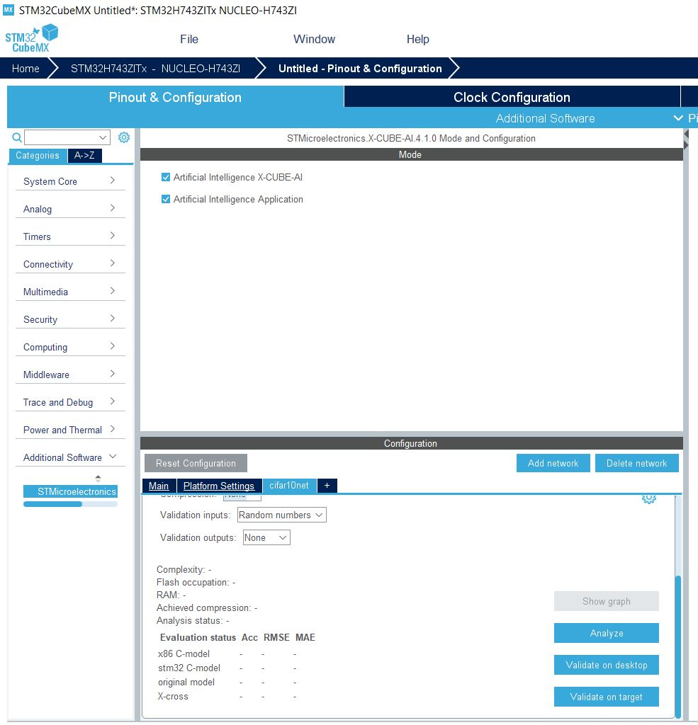
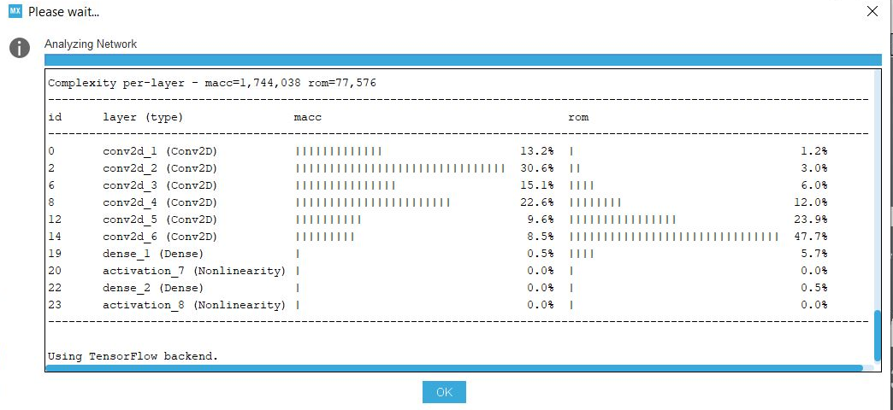
STM32CubeMX-AI: actions
Analyze. Check the correctness of the network. You can choose a level of compression (None, 4, 8)

Slide 19
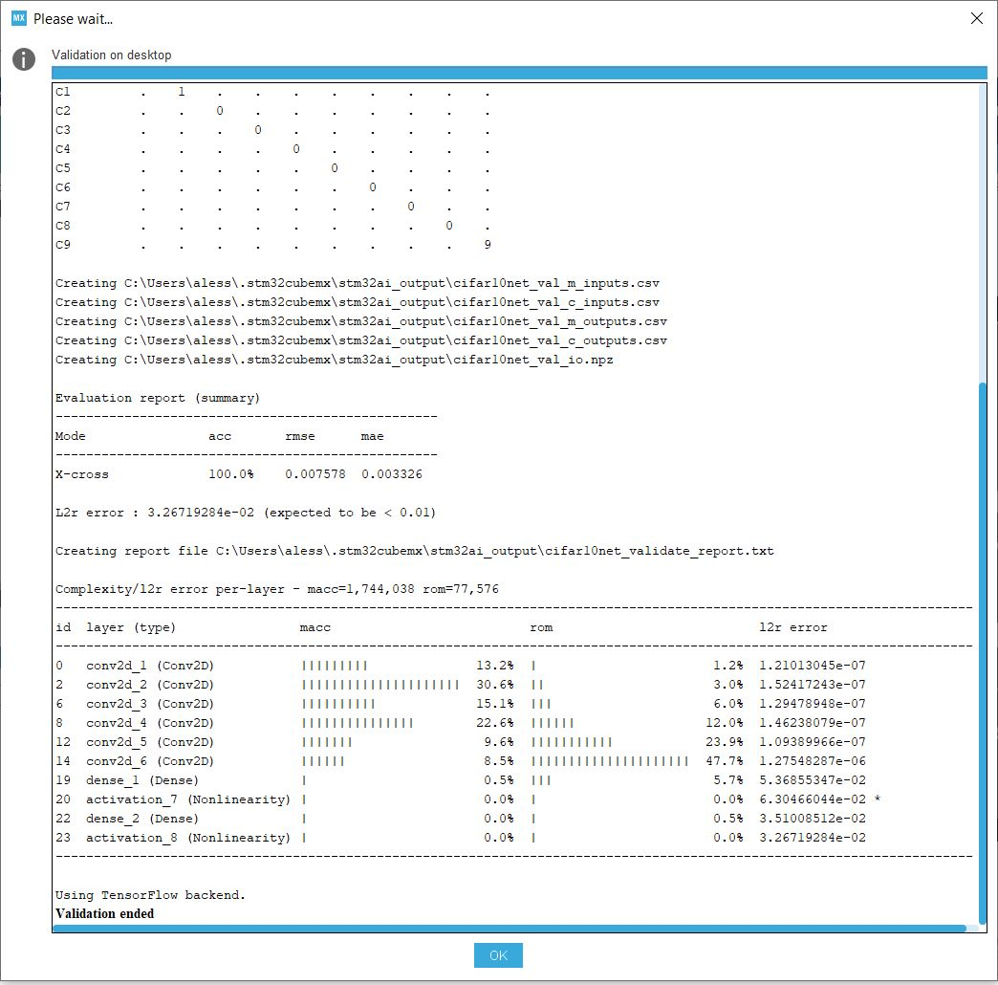
STM32CubeMX-AI: actions
Validate on desktop

Slide 20
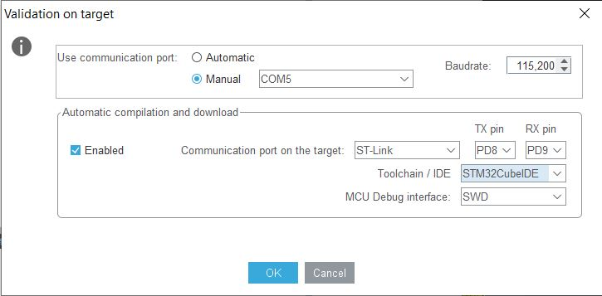
STM32CubeMX-AI: actions
Validate on target: need to have the NUCLEO-H7 plugged.
Select correct IDE and COM

Slide 21
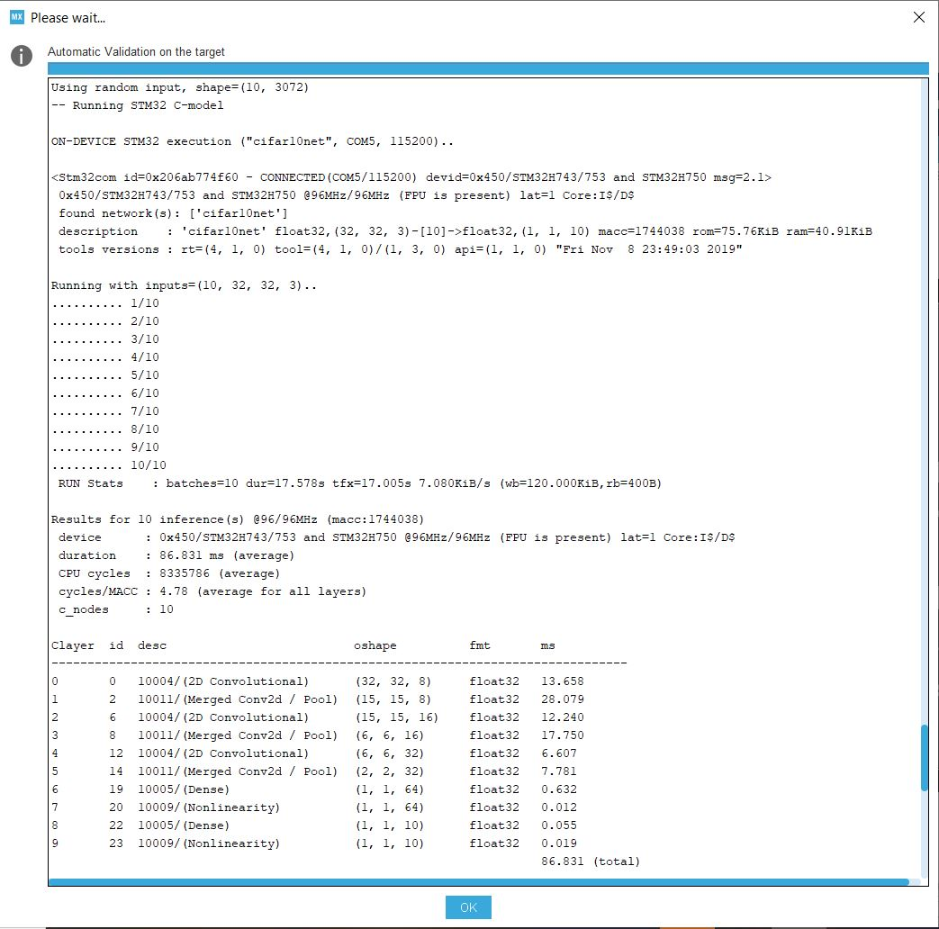
STM32CubeMX-AI: actions
Validate on target: need to have the NUCLEO-H7 plugged.

Slide 22
Summary
Creation of the python network and production of the saved model (.h5)
Creation of the CubeMX project and validation on NUCLEO-H743ZI
Creation of the application for network inference
Application: sending images from PC through serial communication, and classifying them on the board.

Slide 23
Requirements
Saved .h5 model of a trained Neural Network
STM32CubeMX with AI4.1 extension
NUCLEO-H743ZI
Alternatives
Other ST boards.

Slide 24
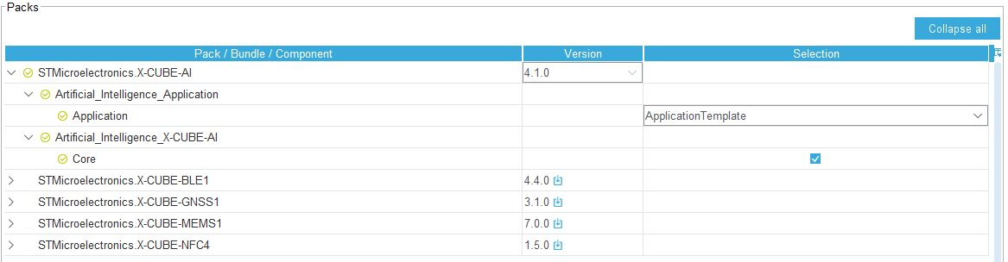
STM32CubeMX-AI: application generation
Change Validation to Application template. The application template allows to Generate the code using the Generate code button.

Slide 25
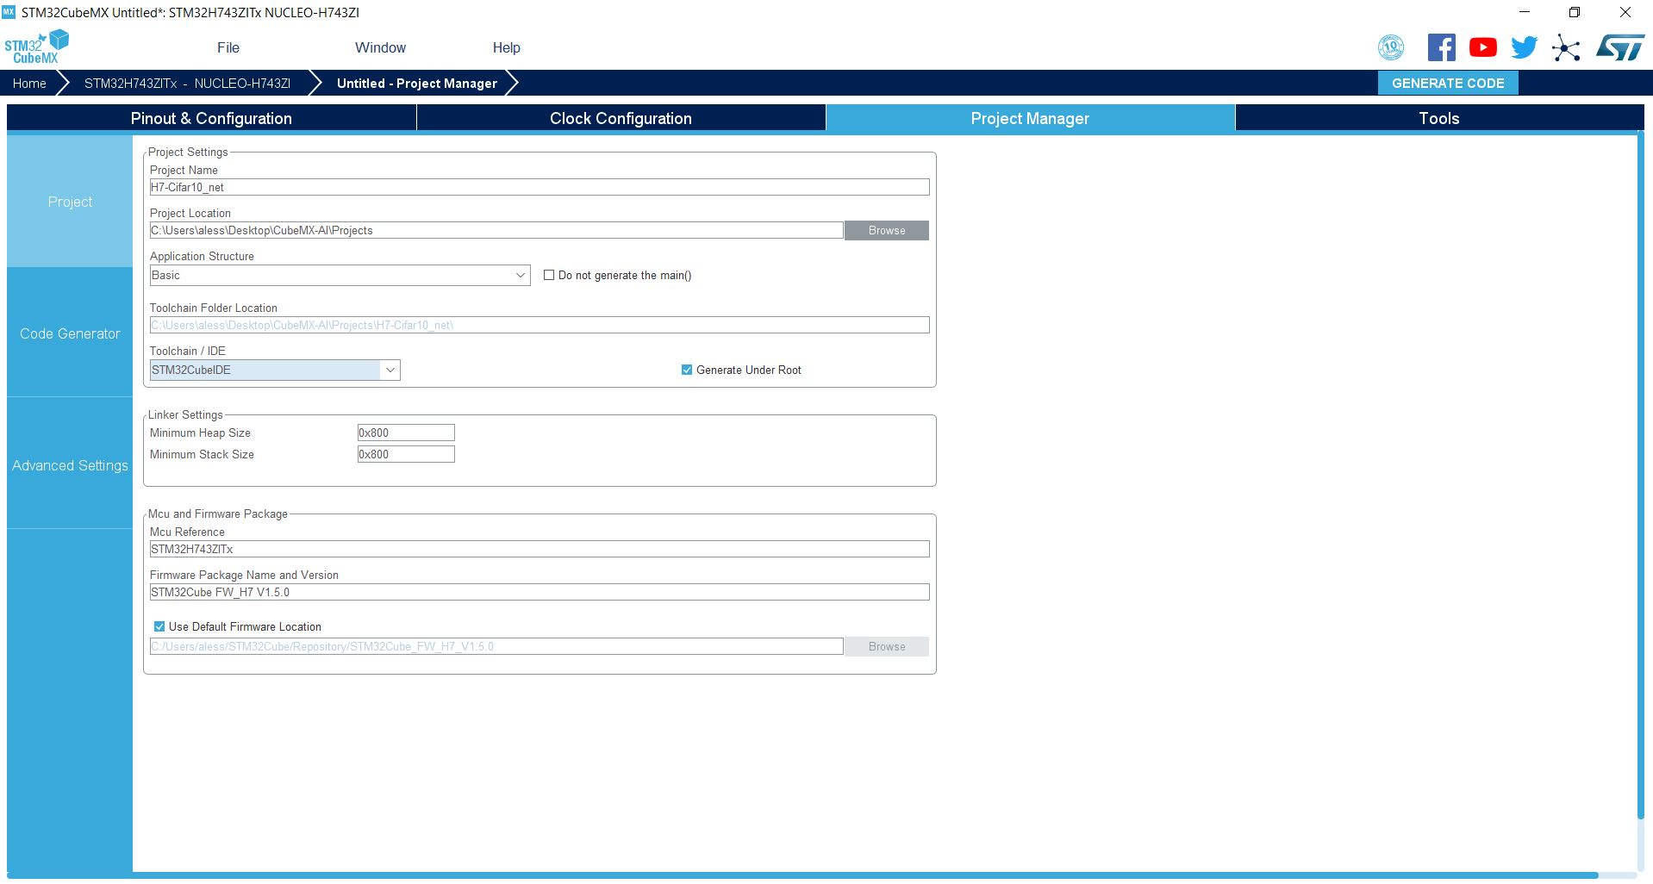
STM32CubeMX-AI: application generation
Go to Project Manager, give a name to the project (three projects are available on Dropbox)

Slide 26
STM32CubeMX-AI: application generation
change the IDE to STM32CubeIDE

Slide 27
STM32CubeMX-AI: application generation
Generate Code

Slide 28
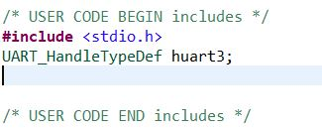
STM32CubeMX-AI Application: add Custom code
Add Custom code to communicate with the NUCLEO Board and classify with the network
USART Receive to receive the image from the PC
USART Transmit to send the results back to the PC
File to be modified → app_x-cube-ai.c
Modifications:
Usart declaration (we used USART3 since it is the one linked to the STLINK)
Usart initialization
Usart communication

Slide 29
STM32CubeMX-AI Application: add Custom code
Usart declaration

Slide 30
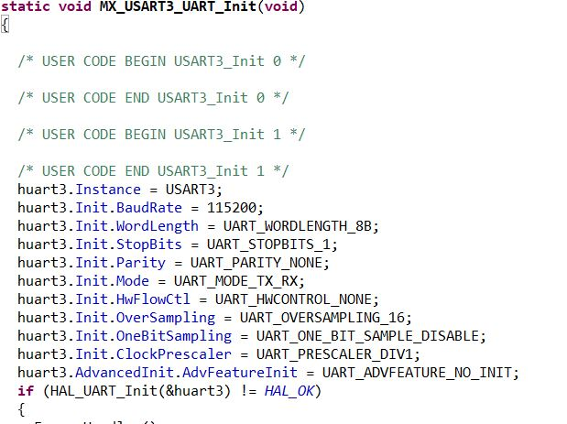
STM32CubeMX-AI Application: add Custom code
Usart declaration
Usart init function declaration (copy from main.c file)

Slide 31
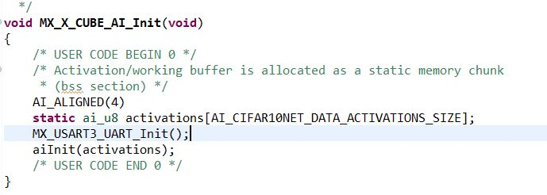
STM32CubeMX-AI Application: add Custom code
Usart declaration
Usart init function declaration (copy from main.c file)
Usart initialization in MX_X_CUBE_AI_Init

Slide 32
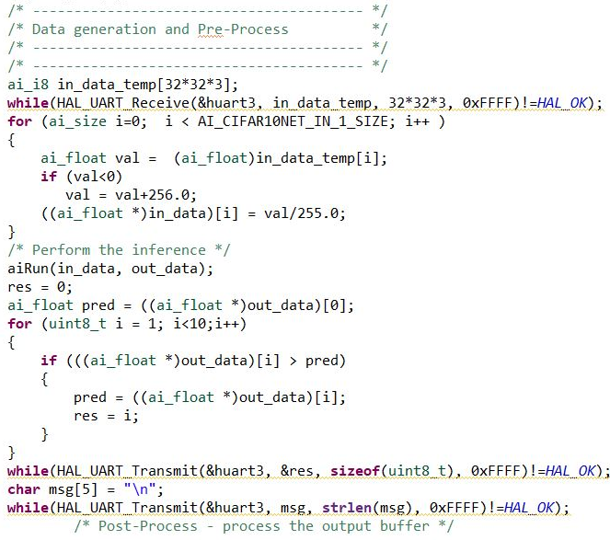
STM32CubeMX-AI Application: add Custom code
Usart declaration
Usart init function declaration (copy from main.c file)
Usart initialization in MX_X_CUBE_AI_Init
MX_X_CUBE_AI_Process → change the input data stream from random data to USART transmitted data

Slide 33
STM32CubeMX-AI Application: load the code
Load the code using the STM32CubeIDE on the board, which will be ready to run the network, waiting for an input image.

Slide 34
Summary
Creation of the python network and production of the saved model (.h5)
Creation of the CubeMX project and validation on NUCLEO-H743ZI
Creation of the application for network inference
Application: sending images from PC through serial communication, and classifying them on the board.

Slide 35
Requirements
Saved .h5 model of a trained Neural Network
NUCLEO-H743ZI
Linux operative system (in our case)

Slide 36
Application: connect the board and classify images
Load the code using the STM32CubeIDE on the board, which will be ready to run the network, waiting for an input image.

Slide 37
Conclusions and alternatives
We used a NUCLEO-H743ZI board. You can change it with other ST boards. N.B. attention to link the USART of the microcontroller to the ST Link, or to use the correct USART in validation/transmission.
We load a Keras float model, compressed by the tool. The compression supported is only for FC layers using 8 bits and eventually a clustering of the weights
You can load .tflite or keras pre-quantized model (support pre quantized 8-bit models)
We load the model without using additional memory
You can also use additional external Flash automatically managed to store weights/activations.

Slide 38
Links
STM32 CubeMX-AI manual
STM32 CubeMX download
STM32 STMCubeIDE
Github project
Dropbox H7 projects

